Slide 1
ICT407: IT Governance in Organisations
Week 5:
Lecturer: Dr. Farshid Keivanian

Slide 2
Business Case
Introduction: A Business Case is a documented justification for initiating a project. It includes the rationale behind the project, expected benefits, cost estimation, risks, and alternatives.
Practical Scenario Presentation: Imagine that an Australian retail company in Sydney is considering whether to invest in a new e-commerce platform. The Business Case for this project will outline the expected increase in online sales, the costs of developing the platform, potential risks (like cybersecurity threats), and alternative strategies, such as enhancing the current website.
Class Discussion Question: What would be the key components of a Business Case for implementing a new e-commerce platform in an established retail company? How would you prioritize these components?

Slide 3
Business Case
Responses:
Justification for the project (increased sales potential)
Cost estimates (development and maintenance)
Risk assessment (cybersecurity)
Alternatives (upgrading the current system)

Slide 4
Business Case
Multiple-Choice Question: Which of the following is not typically included in a Business Case?
Expected Benefits
Project Timeline
Risk Analysis
Customer Feedback
Customer feedback is not typically included in a Business Case. A Business Case usually focuses on elements like Expected Benefits, Project Timeline, and Risk Analysis to justify the start of a project.

Slide 5
Project Goal
Introduction: A Project Goal is the overall objective or purpose of a project. It defines what the project aims to achieve and serves as a guide for project planning and execution.
Practical Scenario Presentation: A Brisbane-based tech startup wants to develop a mobile app to improve customer engagement. The Project Goal might be to increase user engagement by 30% within the first six months of the app’s launch.
Class Discussion Question: What could be some measurable goals for a project focused on developing a mobile app for customer engagement?

Slide 6
Project Goal
Responses:
Increase in app downloads
User retention rate
Customer satisfaction scores
Number of active users

Slide 7
Project Goal
Multiple-Choice Question: What is the primary purpose of setting a Project Goal? A) To allocate resources effectively
B) To define the project's budget
C) To provide a clear direction for the project team
D) To identify potential risks
The primary purpose of setting a Project Goal is to provide a clear direction for the project team, ensuring everyone understands the objectives and works towards a common outcome.

Slide 8
Project Selection Model: Numeric and Non-Numeric
Introduction: Project Selection Models are tools used to evaluate and prioritize projects. Numeric models use quantitative data, while non-numeric models rely on qualitative factors.
Practical Scenario Presentation: A Canberra-based government agency needs to select one of several proposed infrastructure projects. They might use a numeric model like Net Present Value (NPV) to evaluate the financial benefits or a non-numeric model like the Analytic Hierarchy Process (AHP) to consider strategic alignment.
Class Discussion Question: How would you decide between using a numeric or non-numeric project selection model? What factors would influence your choice?

Slide 9
Project Selection Model: Numeric and Non-Numeric
Responses:
The complexity of the project
Availability of quantitative data
The strategic importance of the project
Stakeholder preferences

Slide 10
Project Selection Model: Numeric and Non-Numeric
Each of these methods offers a different approach to project selection, depending on the nature of the project and the criteria most important to the decision-makers.

Slide 11
Project Selection Model: Numeric and Non-Numeric
1. Scoring Model:
Clarification: A Scoring Model is a non-numeric project selection model where various criteria important to the project are identified and assigned weights based on their importance. Each project is scored based on these criteria, and the project with the highest score is selected.
Example: Suppose a company wants to choose between two projects. The criteria might include cost, risk, and alignment with company goals. Each criterion is weighted, and the projects are scored. Project A might score higher on alignment with company goals, while Project B might have a lower risk. The project with the highest overall score is selected.

Slide 12
Project Selection Model: Numeric and Non-Numeric
2. Net Present Value (NPV):
Clarification: NPV is a numeric project selection model used to assess the profitability of a project by calculating the present value of future cash flows, discounted back to their value today.
Example: A company is considering an investment that will cost $1 million today and generate $300,000 per year for the next 5 years. The NPV calculation would discount these future cash flows to their present value and subtract the initial investment. If the NPV is positive, the project is considered profitable.

Slide 13
Project Selection Model: Numeric and Non-Numeric
3. Analytic Hierarchy Process (AHP):
Clarification: AHP is a structured technique for organizing and analyzing complex decisions. It involves breaking down a decision into its constituent parts, arranging these into a hierarchy, and then making pairwise comparisons to assign numerical values to the importance of each element.
Example: A company is trying to select a new software vendor. The decision criteria might include cost, quality, and support. AHP allows the decision-makers to compare these criteria pairwise, assigning a numerical value to each comparison, which ultimately helps to rank the vendors.

Slide 14
Project Selection Model: Numeric and Non-Numeric
4. Delphi Technique:
Clarification: The Delphi Technique is a qualitative project selection method that relies on the consensus of a panel of experts. It involves multiple rounds of questionnaires sent to the experts, with a summary of each round provided to them to refine their responses until a consensus is reached.
Example: An organization wants to forecast the future demand for a new product. They use the Delphi Technique by consulting a panel of market experts, asking them to estimate demand. After several rounds of feedback and refinement, the experts reach a consensus on the most likely scenario.

Slide 15
Project Selection Model: Numeric and Non-Numeric
Multiple-Choice Question: Which of the following is a numeric project selection model?
Scoring Model
Net Present Value (NPV)
Analytic Hierarchy Process (AHP)
Delphi Technique
Net Present Value (NPV) is a numeric project selection model used to evaluate the profitability of a project by calculating the present value of expected cash flows.

Slide 16
Choosing Project Selection Model
Introduction: Choosing the right Project Selection Model involves evaluating the project's objectives, available data, and the decision-making process.
Practical Scenario Presentation: A Sydney-based construction firm is selecting between multiple residential development projects. They need to choose a model that balances financial returns with community impact.
Class Discussion Question: What criteria would you consider when selecting a project selection model for a construction project? How would you ensure that the chosen model aligns with the company's strategic goals?

Slide 17
Choosing Project Selection Model
Responses:
Financial returns (using NPV or IRR)
Community impact (using a scoring model)
Strategic alignment
Resource availability

Slide 18
Choosing Project Selection Model
Multiple-Choice Question: What is the most critical factor in choosing a Project Selection Model?
The size of the project team
The availability of data
The project timeline
The company's industry
The availability of data is the most critical factor in choosing a Project Selection Model, as it determines which models can be effectively applied and how accurate the results will be. Without sufficient and reliable data, the selection process may not yield meaningful or actionable insights.

Slide 19
Open-Ended Question
Primary Question: Consider a project you are familiar with (real or hypothetical). What project selection model would you use and why? What are the expected outcomes of using this model?
I would use the Net Present Value (NPV) model for a capital investment project because it provides a clear measure of the project's profitability. The expected outcome is a data-driven decision that ensures the project will generate a positive return on investment.

Slide 20
Open-Ended Question
Follow-Up Question:
How would your choice of model change if the project's scope were larger or if the project had a different strategic goal?
If the project's scope were larger or had different strategic goals, I might use the Scoring Model to evaluate multiple criteria, such as alignment with strategic objectives, risk, and potential benefits, as it allows for a broader and more qualitative assessment.

Slide 21
Open-Ended Question
Explanation:
The selection of a project model should align with the organization's objectives and the project's strategic importance. Numeric models offer a data-driven approach, while non-numeric models provide flexibility in evaluating qualitative factors.
Answer: Numeric models like NPV are ideal for projects where financial return is the primary concern. Non-numeric models, such as the Scoring Model, are better for projects where qualitative factors, such as strategic alignment, are critical.

Slide 22
Open-Ended Question
Group Activity:
Choose a project selection model for a project you are interested. Each group should present their chosen model and explain why it aligns with the project's goals. Discuss the pros and cons of each model.
Groups may choose models like NPV, Scoring Model, or AHP based on the project's goals. For instance, NPV is suited for financial projects, while the Scoring Model might be better for strategic projects. The discussion would include the advantages, such as clarity and focus of NPV, versus the flexibility and comprehensiveness of the Scoring Model.

Slide 23
Preparation for Assessment 2 - Week 6 (Semester 2, 2024)
As we approach Week 6, I want to provide you with clear instructions for completing Assessment 2. This assessment consists of two parts: Short Answer Questions and Report Submission. Please follow the steps below carefully.
Part 1: Short Answer Questions
Date and Time:
This part of the assessment will take place during our regular tutorial session in Week 6.
You will have 1 hour to complete the Short Answer Questions.

Slide 24
Preparation for Assessment 2 - Week 6 (Semester 2, 2024)
2. Assessment Environment:
The assessment is invigilated and closed book. It will be conducted in the classroom, and you must be present.
3. Accessing the Questions:
During the tutorial, I will open the LMS (Learning Management System) and navigate to This course >> Assignments >> Assessment 2.
I will display the questions on the screen. Please note that the questions are only viewable by lecturers.

Slide 25
Preparation for Assessment 2 - Week 6 (Semester 2, 2024)
4. Answering the Questions:
You will write your answers on paper. Please make sure to include your name and student ID on your answer sheet.
Once you have completed the questions, submit your paper to me.
5. Marking:
I will mark your answers and enter the results into the LMS.

Slide 26
Preparation for Assessment 2 - Week 6 (Semester 2, 2024)
Part 2: Report Submission
Courses Involved:
The report submission applies to students enrolled in ICT408, ICT502, ICT1101, and ICT1103.
Submission Window:
The online submission will be open from Friday, 30th August 2024 until Sunday, 1st September 2024.
Submission Process:
You will submit your report through the LMS under Assignments >> Assessment 2.
Please ensure your report meets the required quality standards as outlined in the provided rubrics.

Slide 27
Preparation for Assessment 2 - Week 6 (Semester 2, 2024)
Part 2: Report Submission
Courses Involved:
The report submission applies to students enrolled in ICT408, ICT502, ICT1101, and ICT1103.
Submission Window:
The online submission will be open from Friday, 30th August 2024 until Sunday, 1st September 2024.
Submission Process:
You will submit your report through the LMS under Assignments >> Assessment 2.
Please ensure your report meets the required quality standards as outlined in the provided rubrics.

Slide 28
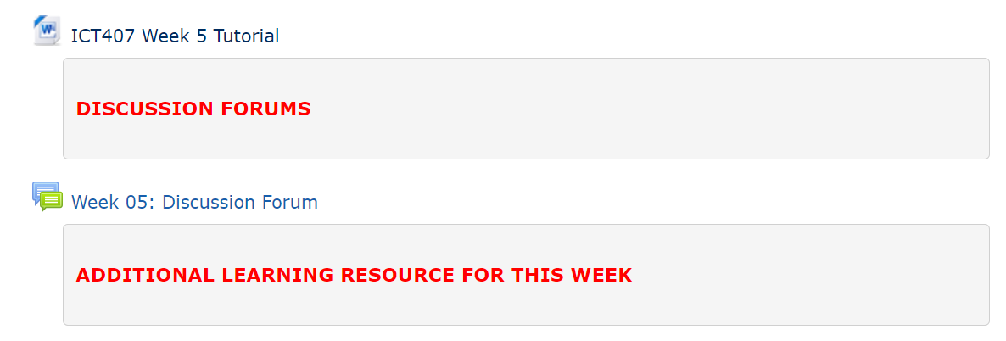
Tutorial Week 5

Slide 29
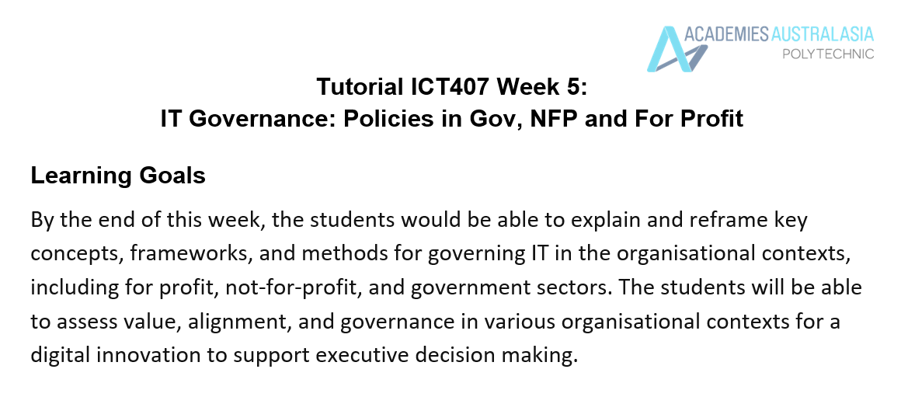
Tutorial Week 5

Slide 30
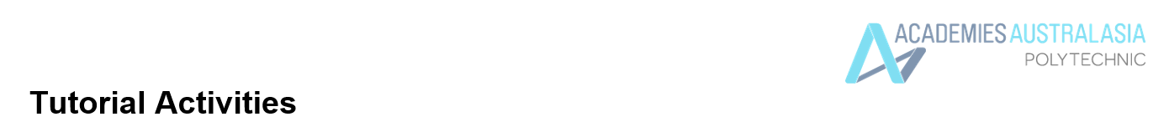
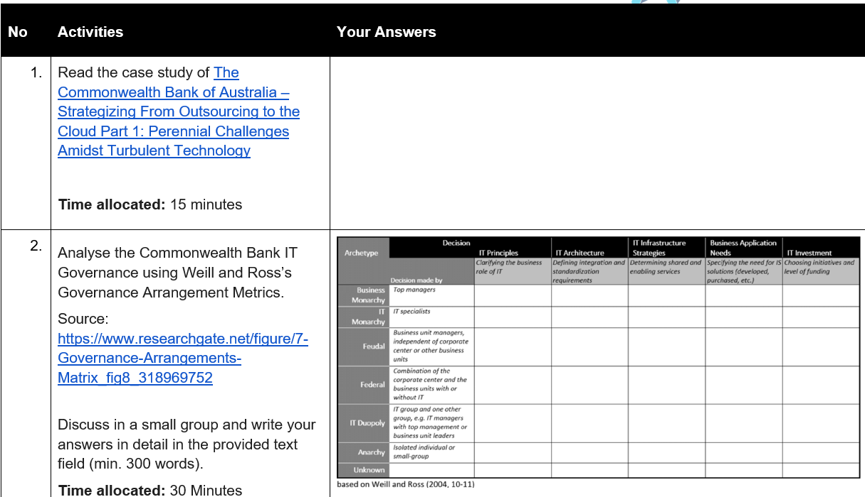
Tutorial Week 5

Slide 31
Tutorial Week 5
To analyze the Commonwealth Bank of Australia's IT Governance using Weill and Ross’s Governance Arrangement Metrics, we'll want to examine the decision-making archetypes presented in the matrix and apply them to the bank's situation as described in the case study.
Step-by-Step Analysis:
Understanding the Case Study:
The Commonwealth Bank of Australia (CBA) has faced various IT management challenges over the years, including IT outsourcing, adopting new technologies, and evolving IT governance structures.
Key aspects discussed include what type of outsourcing is appropriate at different stages and how IT governance arrangements need to evolve as the organization grows and changes.

Slide 32
Tutorial Week 5
2. Governance Arrangement Metrics:
Archetypes:
Business Monarchy: Decisions made by top managers.
IT Monarchy: Decisions made by IT specialists.
Feudal: Decisions made by business unit managers independently.
Federal: Combination of corporate center and business units with or without IT.
IT Duopoly: IT group and another group, such as business unit leaders, make decisions together.
Anarchy: Decisions made by isolated individuals or small groups.

Slide 33
Tutorial Week 5
Decision Domains:IT Principles: Clarifying the business role of IT.
IT Architecture: Defining integration and standardization requirements.
IT Infrastructure Strategies: Determining shared and enabling services.
Business Application Needs: Specifying the need for IS solutions.
IT Investment: Choosing initiatives and level of funding.

Slide 34
Tutorial Week 5
3. Applying the Matrix to CBA:
IT Principles:
Likely determined at the Federal level, involving both corporate center and business units, given the importance of aligning IT strategy with business objectives.
IT Architecture:
Decisions might be made at the IT Monarchy level, given the technical nature of defining integration and standardization requirements.
IT Infrastructure Strategies:
Possibly a Federal or IT Duopoly approach, where both the IT group and business leaders are involved to ensure that shared services meet both technical and business needs.
Business Application Needs:
Likely decided at the Feudal level, as different business units might have specific requirements for IS solutions, although there could be Federal oversight.
IT Investment:
Decisions are probably made at the Business Monarchy or Federal level, where top management or a combination of corporate and business units decide on funding and initiatives.

Slide 35
Tutorial Week 5
4. Discussion Points for Group Activity:
How do the IT governance archetypes align with the decision-making processes described in the case study?
What are the benefits and potential challenges of CBA adopting a more centralized (Business Monarchy) versus decentralized (Feudal or Federal) IT governance approach?
How might the decision-making process evolve as CBA continues to adopt new technologies and move towards cloud solutions?
5. Writing the Answer (300 words):
In your group discussion, you should consider how CBA's governance arrangements have evolved over time. Reflect on the benefits of a centralized versus decentralized approach and how these governance structures impact the effectiveness of IT decision-making in the context of a large organization like CBA. Discuss how the matrix can be applied to assess the effectiveness of CBA's current IT governance structure, particularly as it continues to innovate and adopt new technologies.

Slide 36
Tutorial Week 5
Additional Points to Consider:
Impact of Outsourcing: How does outsourcing influence the governance archetype at CBA?
Challenges in Evolution: What are the primary challenges CBA faces in evolving its IT governance structure to adapt to new technology demands?
Practical Application: How can CBA use these metrics to refine its IT governance to better support its strategic objectives?
By engaging in this exercise, your group will gain a deeper understanding of how governance frameworks like the one provided by Weill and Ross can be applied to real-world scenarios in IT management.

Slide 37
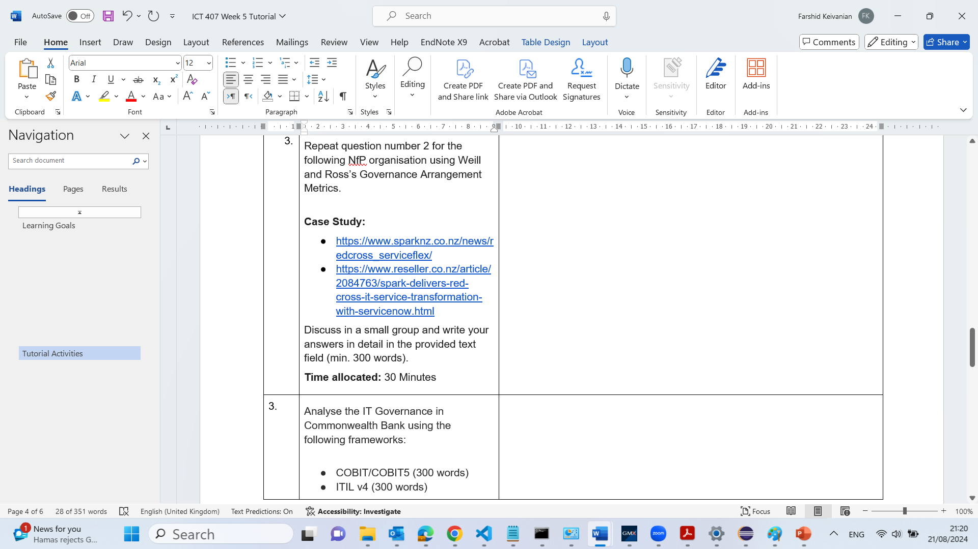
Tutorial Week 5

Slide 38
Tutorial Week 5
To analyze the IT Governance at New Zealand Red Cross using Weill and Ross’s Governance Arrangement Metrics, we'll focus on the decision-making processes described in the case study involving their IT service transformation using ServiceNow and Spark's ServiceFlex platform.
Step-by-Step Analysis:
Understanding the Case Study:
New Zealand Red Cross (NZRC) partnered with Spark to transform their IT service management (ITSM) using the ServiceFlex platform, which is built on ServiceNow.
The transformation led to significant improvements, such as a 60% reduction in ticket count and a 25% reduction in calls to the service desk, allowing NZRC to focus more on strategic initiatives.
The case highlights the importance of technology in supporting NZRC's mission and the need for an effective IT governance structure to manage these transformations.

Slide 39
Tutorial Week 5
2. Governance Arrangement Metrics:
Archetypes:
Business Monarchy: Decisions made by top managers.
IT Monarchy: Decisions made by IT specialists.
Feudal: Decisions made by business unit managers independently.
Federal: Combination of corporate center and business units with or without IT.
IT Duopoly: IT group and another group, such as business unit leaders, make decisions together.
Anarchy: Decisions made by isolated individuals or small groups.
Decision Domains:
IT Principles: Clarifying the business role of IT.
IT Architecture: Defining integration and standardization requirements.
IT Infrastructure Strategies: Determining shared and enabling services.
Business Application Needs: Specifying the need for IS solutions.
IT Investment: Choosing initiatives and level of funding.

Slide 40
Tutorial Week 5
3. Applying the Matrix to NZ Red Cross:
IT Principles:
Likely governed by a Federal approach where decisions are made collaboratively between the organizational services (business units) and the IT department, ensuring that IT strategies align with NZRC’s mission.
IT Architecture:
Decisions might be made under an IT Monarchy where IT specialists define how ServiceFlex and ServiceNow are integrated into the existing architecture.
IT Infrastructure Strategies:
This could follow an IT Duopoly model where the IT team works closely with business leaders to ensure that the ServiceFlex platform supports shared services across the organization.
Business Application Needs:
Likely a Feudal or Federal decision-making process, where individual business units or a combination of business and IT decide on specific applications and tools needed to enhance their operations.
IT Investment:
Decisions are probably made at the Business Monarchy level where top management determines how donor funds are allocated to IT initiatives, ensuring alignment with the broader organizational goals.

Slide 41
Tutorial Week 5
4. Discussion Points for Group Activity:
How do the IT governance archetypes apply to the decision-making processes at NZRC, especially in the context of their IT transformation?
What are the benefits and potential challenges of the governance structure at NZRC, particularly when involving multiple stakeholders like IT specialists, business managers, and top management?
How does the integration of ServiceFlex and ServiceNow reflect the organization's IT governance maturity and its ability to adapt to new technologies?
5. Writing the Answer (300 words):
In your group discussion, consider how NZRC’s IT governance structure facilitated the successful implementation of ServiceFlex. Reflect on the balance between centralized and decentralized decision-making and how it contributed to achieving the goals of reducing ticket counts and improving service delivery. Discuss how the metrics can help assess and improve IT governance at NZRC, particularly as they continue to leverage technology for strategic purposes.

Slide 42
Tutorial Week 5
Additional Points to Consider:
Impact of ITSM Transformation: How does the new ITSM system affect decision-making processes within NZRC, and what governance archetype does it most align with?
Challenges in Governance: What governance challenges might arise as NZRC continues to evolve its IT infrastructure, and how can these challenges be mitigated?
Practical Application: How can NZRC use the governance arrangement metrics to further enhance its IT governance framework, especially as it scales its IT services?
By engaging in this exercise, your group will gain insights into how governance frameworks can be applied to real-world scenarios, particularly in the not-for-profit sector, where resource allocation and strategic alignment are critical.

Slide 43
Tutorial Week 5
IT Governance in Commonwealth Bank using COBIT/COBIT5 (300 words)
COBIT (Control Objectives for Information and Related Technology) and its evolution to COBIT 5 provide a comprehensive framework for the governance and management of enterprise IT. In the context of the Commonwealth Bank of Australia (CBA), COBIT/COBIT5 can be applied to ensure that IT aligns with business goals, effectively manages risk, and delivers value to stakeholders.

Slide 44
Tutorial Week 5
1. Alignment of IT with Business Goals:
COBIT 5 emphasizes the alignment of IT with the overall strategic objectives of the organization. For CBA, this alignment is critical given the bank's reliance on technology for competitive advantage, customer service, and operational efficiency. COBIT 5's APO (Align, Plan, and Organize) domain would help CBA in aligning IT strategies with business goals, ensuring that IT initiatives directly support the bank's objectives, such as improving customer experience or expanding digital banking services.

Slide 45
Tutorial Week 5
2. Risk Management:
Effective risk management is central to COBIT 5. CBA, as a large financial institution, faces significant risks related to cybersecurity, data privacy, and regulatory compliance. COBIT 5's MEA (Monitor, Evaluate, and Assess) domain provides guidelines for continuously monitoring IT processes and risk management practices. This would enable CBA to identify potential risks early and implement appropriate controls, minimizing the impact on the bank’s operations.

Slide 46
Tutorial Week 5
3. Value Delivery:
COBIT 5 also focuses on ensuring that IT investments deliver value to the organization. In CBA’s case, IT investments are substantial, covering areas like cloud computing, AI-driven customer services, and cybersecurity. The BAI (Build, Acquire, and Implement) domain would assist CBA in managing these investments, from project initiation through to implementation, ensuring that they deliver expected benefits and are completed on time and within budget.

Slide 47
Tutorial Week 5
4. Performance Measurement:
COBIT 5 promotes the use of key performance indicators (KPIs) to measure the success of IT governance and management practices. For CBA, KPIs might include metrics like system uptime, incident response times, or return on IT investment, which can be tracked using the DSS (Deliver, Service, and Support) domain to ensure that IT services are reliable and meet stakeholder expectations.

Slide 48
Tutorial Week 5
In conclusion, by applying COBIT/COBIT5, CBA can ensure that its IT governance framework not only aligns with business objectives but also effectively manages risks, delivers value, and measures performance, thus supporting the bank’s overall strategic goals.

Slide 49
Tutorial Week 5
IT Governance in Commonwealth Bank using ITIL v4 (300 words)
The IT Infrastructure Library (ITIL) v4 framework is designed to guide organizations in managing and delivering IT services that align with business needs. In the context of Commonwealth Bank of Australia (CBA), ITIL v4 can be instrumental in enhancing service delivery, optimizing processes, and ensuring customer satisfaction.
1. Service Value System (SVS):
ITIL v4 introduces the Service Value System (SVS), which integrates various components to facilitate value creation through IT services. For CBA, the SVS can help in aligning its IT services with the bank's strategic objectives, such as improving customer experience through seamless digital banking services. The SVS would ensure that all IT service management activities contribute to delivering value to both customers and the bank.
2. ITIL Guiding Principles:
ITIL v4 emphasizes guiding principles like "Focus on Value," "Start Where You Are," and "Collaborate and Promote Visibility." CBA can apply these principles to ensure that all IT services are customer-centric, leverage existing capabilities, and foster collaboration across departments. For example, when implementing new digital banking features, CBA can focus on the value delivered to customers, ensuring that the new features meet customer needs and enhance their banking experience.

Slide 50
Tutorial Week 5
3. Service Management Practices:
ITIL v4 outlines 34 management practices, including Service Level Management, Incident Management, and Change Control, which are crucial for maintaining high service quality. CBA can use these practices to ensure that IT services are reliable, secure, and responsive. For instance, by implementing robust Incident Management practices, CBA can minimize service disruptions, quickly resolve incidents, and maintain customer trust.
4. Continual Improvement:
Continual Improvement is a core component of ITIL v4, focusing on regularly assessing and enhancing IT services. CBA can establish a Continual Improvement culture within its IT department, encouraging teams to continuously look for ways to enhance service delivery, optimize processes, and reduce costs. This could involve regular reviews of service performance, feedback collection from customers, and the implementation of new technologies to improve service efficiency.

Slide 51
Tutorial Week 5
5. ITIL Service Value Chain (SVC):
The Service Value Chain (SVC) in ITIL v4 provides a flexible operating model for the creation, delivery, and continual improvement of services. CBA can utilize the SVC to ensure that its IT services are well-coordinated and adapt to changing business needs. For example, in the rollout of new mobile banking features, the SVC can help CBA ensure that these services are developed, tested, and deployed in a way that maximizes value and minimizes risk.
By implementing ITIL v4, CBA can enhance its IT service management, ensuring that services are aligned with business goals, customer-focused, and continuously improving.

Slide 52
Tutorial Week 5
IT Governance in Commonwealth Bank using ISO/IEC 27001:2005 (300 words)
ISO/IEC 27001:2005 is an international standard for information security management systems (ISMS), providing a systematic approach to managing sensitive company information. In the context of Commonwealth Bank of Australia (CBA), applying ISO/IEC 27001:2005 can strengthen the bank’s security posture, ensuring the protection of critical data and compliance with regulatory requirements.
1. Establishing an Information Security Management System (ISMS):
ISO/IEC 27001:2005 requires organizations to establish, implement, maintain, and continuously improve an ISMS. For CBA, this involves developing a structured framework for managing information security risks. The ISMS would cover policies, procedures, and controls to protect sensitive information, such as customer data, financial records, and intellectual property, ensuring confidentiality, integrity, and availability.

Slide 53
Tutorial Week 5
2. Risk Assessment and Treatment:
A core aspect of ISO/IEC 27001:2005 is conducting regular risk assessments to identify potential security threats and vulnerabilities. CBA would need to evaluate the likelihood and impact of various security risks and implement appropriate controls to mitigate them. For example, risks associated with cyberattacks, insider threats, and data breaches can be systematically identified and addressed through controls like encryption, access management, and incident response planning.

Slide 54
Tutorial Week 5
3. Legal and Regulatory Compliance:
ISO/IEC 27001:2005 emphasizes the importance of compliance with relevant legal and regulatory requirements. For CBA, this means ensuring that its information security practices meet the standards set by Australian laws and financial regulations. The bank must regularly review its compliance status, update its ISMS to reflect changes in regulations, and ensure that all employees are aware of their legal obligations regarding information security.

Slide 55
Tutorial Week 5
4. Security Controls:
The standard includes a comprehensive set of security controls (Annex A) that CBA can implement to protect its information assets. These controls cover areas such as physical security, access control, network security, and incident management. For instance, implementing strong access controls would ensure that only authorized personnel can access sensitive financial data, thereby reducing the risk of data breaches.

Slide 56
Tutorial Week 5
5. Continual Improvement:
ISO/IEC 27001:2005 requires organizations to continually monitor and improve their ISMS. For CBA, this involves regular audits, management reviews, and risk assessments to identify areas for improvement. The bank can use these insights to refine its security policies, update controls, and ensure that its ISMS remains effective in the face of evolving security threats.
6. Incident Response and Recovery:
The standard also emphasizes the importance of having a robust incident response and recovery plan. For CBA, this means developing and testing procedures to respond to and recover from security incidents, such as data breaches or system outages. A well-defined incident response plan would ensure that CBA can quickly contain and mitigate the impact of a security breach, minimizing damage to its reputation and operations.

Slide 57
Tutorial Week 5
By adopting ISO/IEC 27001:2005, CBA can establish a robust ISMS that not only protects its information assets but also enhances its resilience against security threats, ensuring the trust of its customers and compliance with regulatory requirements.

Slide 58
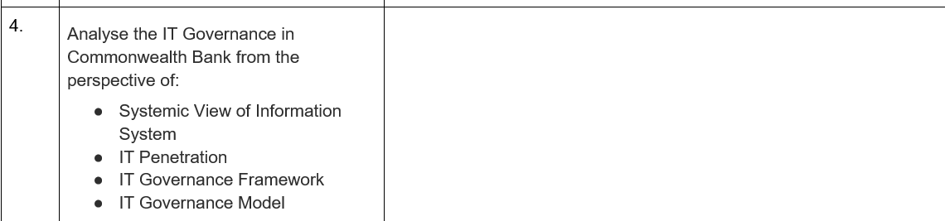
Tutorial Week 5
IT Governance in Commonwealth Bank from the Perspective of Systemic View of Information Systems
A Systemic View of Information Systems (IS) considers the interconnectedness of various components within an organization’s IT landscape, emphasizing how these elements work together to achieve business goals. For the Commonwealth Bank of Australia (CBA), this approach is crucial given the bank’s reliance on complex IT systems to deliver financial services.
1. Integration of Systems:
CBA’s IT infrastructure is likely composed of various interconnected systems, including core banking systems, customer relationship management (CRM) platforms, and cybersecurity frameworks. A systemic view ensures that these systems are not only individually robust but also seamlessly integrated. For example, CBA’s digital banking services must integrate with back-end systems to provide real-time data access and secure transactions.

Slide 59
Tutorial Week 5
2. Information Flow and Data Management:
In a systemic approach, the flow of information across different IT systems is critical. CBA needs to ensure that data is consistent, accurate, and timely across all its platforms. This includes customer data, transaction records, and compliance-related information. Effective data management practices within a systemic view help CBA maintain data integrity, reduce redundancy, and ensure that all parts of the organization have access to the same accurate information.
3. Resilience and Risk Management:
A systemic view also involves assessing the resilience of the entire IT ecosystem. CBA must ensure that each component of its IT infrastructure is resilient to disruptions and that there are robust disaster recovery plans in place. For instance, a failure in one system, like online banking, should not cascade into other systems, disrupting the entire operation. This requires a comprehensive risk management strategy that considers the interdependencies between systems.

Slide 60
Tutorial Week 5
4. Organizational Alignment:
The systemic view also emphasizes the alignment of IT systems with organizational goals. For CBA, this means ensuring that all IT initiatives support the bank’s strategic objectives, such as enhancing customer experience or expanding digital services. Each system and its function should be aligned with the broader business strategy, ensuring that IT investments contribute to achieving organizational goals.

Slide 61
Tutorial Week 5
IT Governance in Commonwealth Bank from the Perspective of IT Penetration
IT Penetration refers to the extent to which IT systems and practices are embedded within an organization’s operations and culture. At the Commonwealth Bank of Australia (CBA), IT penetration is likely to be high, given the bank’s reliance on technology to deliver services, manage operations, and compete in the financial sector.
1. Pervasive Use of Technology:
CBA demonstrates high IT penetration with its extensive use of digital banking platforms, mobile applications, and automated customer service systems. IT is deeply embedded in the day-to-day operations of the bank, enabling it to offer services that meet the needs of a tech-savvy customer base. For instance, mobile banking and online transaction services are critical components of CBA’s service offering, reflecting the deep penetration of IT into its customer engagement strategies.

Slide 62
Tutorial Week 5
2. Integration with Core Processes:
IT systems are integrated with core banking processes such as transaction processing, risk management, and regulatory compliance. This integration ensures that IT is not a separate entity but is interwoven with the bank’s operational framework. For example, real-time fraud detection systems are integrated into transaction processing workflows, allowing CBA to quickly identify and respond to potential security threats.

Slide 63
Tutorial Week 5
3. Culture of IT Adoption:
High IT penetration at CBA is also reflected in the organizational culture, where there is a strong focus on continuous improvement and innovation through technology. Employees across the organization are likely encouraged to adopt and leverage IT tools to enhance productivity and efficiency. Training programs and initiatives that promote digital literacy among staff further reinforce this culture of IT adoption.
4. Impact on Decision-Making:
The penetration of IT into decision-making processes is another indicator. At CBA, decisions related to customer service, product development, and risk management are likely informed by data analytics and insights derived from IT systems. The bank’s leadership likely relies on IT-driven data to make informed decisions that align with strategic objectives.

Slide 64
Tutorial Week 5
IT Governance in Commonwealth Bank from the Perspective of IT Governance Framework
An IT Governance Framework provides the structure through which an organization ensures that IT investments support business goals and deliver value. For CBA, a robust IT governance framework is essential to manage its extensive IT infrastructure and ensure alignment with its business strategy.
1. Strategic Alignment:
CBA’s IT governance framework likely emphasizes the alignment of IT with business strategy. This ensures that IT initiatives are directly linked to the bank’s goals, such as enhancing customer experience, increasing operational efficiency, and ensuring regulatory compliance. A governance framework like COBIT or ITIL might be used to guide this alignment, ensuring that IT projects are prioritized based on their strategic impact.

Slide 65
Tutorial Week 5
2. Performance Management:
Within the framework, performance management is crucial for measuring the effectiveness of IT initiatives. CBA likely employs key performance indicators (KPIs) to track the performance of IT services, such as system uptime, response times, and customer satisfaction. These metrics help the bank assess whether IT is delivering the expected value and where improvements may be needed.
3. Risk Management:
Risk management is a central component of IT governance at CBA. The governance framework would include policies and processes for identifying, assessing, and mitigating IT-related risks. This is particularly important in the financial sector, where risks related to cybersecurity, data privacy, and regulatory compliance are significant. Regular risk assessments and audits are likely conducted to ensure that IT risks are managed effectively.

Slide 66
Tutorial Week 5
4. Resource Management:
Effective IT governance at CBA would also involve resource management, ensuring that IT resources (including human resources, budget, and technology) are used efficiently and effectively. The governance framework would include guidelines for budgeting, resource allocation, and project management to ensure that IT resources are aligned with business priorities and deliver maximum value.
5. Compliance and Accountability:
The governance framework would also emphasize compliance with relevant laws and regulations, such as data protection laws and financial regulations. At CBA, IT governance ensures that the bank meets its legal obligations and that there is clear accountability for IT decisions. This might involve regular audits, compliance checks, and reporting mechanisms to ensure transparency and accountability in IT governance.

Slide 67
Tutorial Week 5
IT Governance in Commonwealth Bank from the Perspective of IT Governance Model
An IT Governance Model provides a specific structure and roles for decision-making in IT, ensuring that IT supports and aligns with the organization’s objectives. At CBA, an effective IT governance model is critical for managing the complexity of IT operations across a large financial institution.
1. Centralized vs. Decentralized Model:
CBA may use a hybrid IT governance model, balancing centralized control with decentralized decision-making. In a centralized model, key IT decisions (such as IT strategy and investment) might be made by a central IT governance body, ensuring alignment with the bank’s overall strategy. Meanwhile, decentralized decision-making could empower business units to make IT decisions related to their specific needs, fostering agility and responsiveness.

Slide 68
Tutorial Week 5
2. Roles and Responsibilities:
The IT governance model at CBA likely defines clear roles and responsibilities for IT decision-making. This includes the roles of the CIO, IT steering committees, and business unit leaders. The CIO might be responsible for overall IT strategy and governance, while business unit leaders are involved in decisions that affect their specific areas. IT steering committees might oversee major IT projects, ensuring they align with strategic goals and are delivered on time and within budget.
3. Decision-Making Processes:
The governance model would also outline the decision-making processes for IT initiatives. At CBA, this might involve a formalized process for evaluating and approving IT projects, including criteria for assessing the strategic value, risk, and resource requirements of each project. This ensures that IT investments are made wisely and deliver the expected benefits.

Slide 69
Tutorial Week 5
4. Integration with Corporate Governance:
The IT governance model at CBA would be integrated with the broader corporate governance framework, ensuring that IT decisions are aligned with corporate objectives and are subject to the same oversight and accountability mechanisms. This might involve regular reporting to the board of directors on IT performance, risks, and strategic initiatives.
5. Continuous Improvement:
Finally, the IT governance model at CBA would include mechanisms for continuous improvement. This could involve regular reviews of the governance model itself, as well as the performance of IT initiatives, to identify areas for improvement. The model might also incorporate feedback loops, allowing lessons learned from IT projects to be incorporated into future governance processes.

Slide 70
Tutorial Week 5
In summary, CBA’s IT governance can be analyzed through various perspectives, including a systemic view of information systems, IT penetration, IT governance framework, and IT governance model. Each perspective provides insights into how the bank manages its IT resources, aligns IT with business goals, and ensures that IT delivers value while managing risks and ensuring compliance.

